Slide 1
Envision Hybrid Demonstration
Miracle Advance Technologies co. ltd.

Slide 2
Introduction

Slide 3
Features
Site Registration
Approve Site and user
User login
Study Worklist
Open PACS image from Cloud
Resend request
Relay
Router

Slide 4
Technology
Angular 8 and primeng controls are used for client side application
Asp.Net Core, C#, Web Api core 3.0 and Entity Framework Core are used for server side
SQL Server 2017 for Database
SQL Server Reporting Service is used for Reports

Slide 5
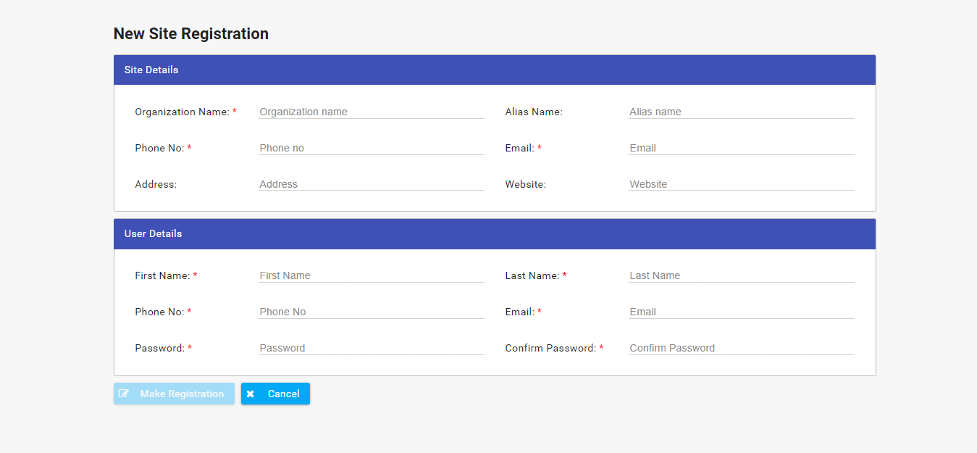
Present
Site Registration

Slide 6
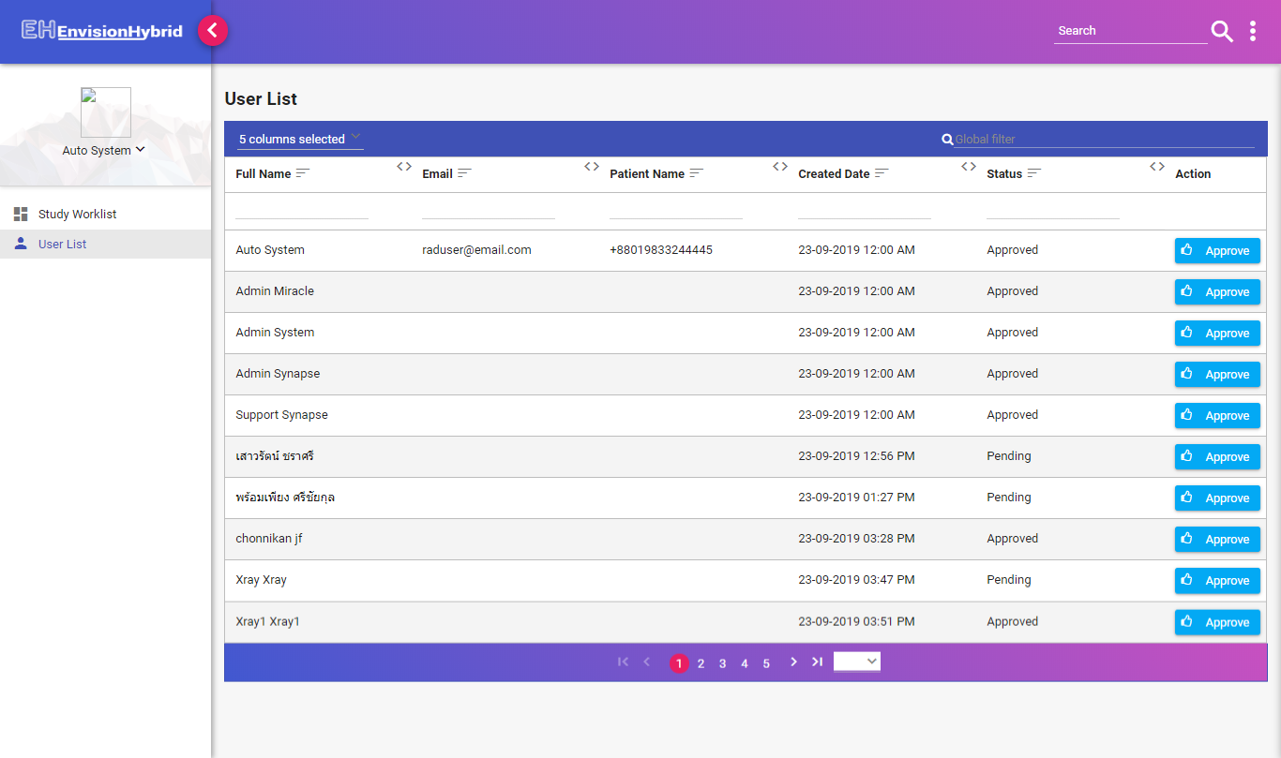
Present
Site and User Approval

Slide 7
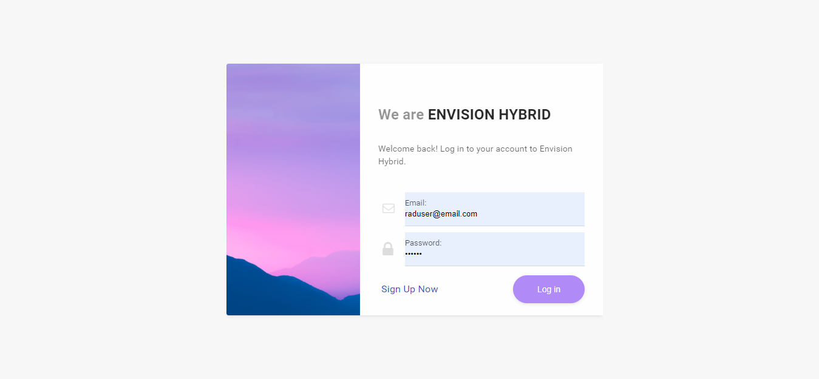
Present
User Login

Slide 8
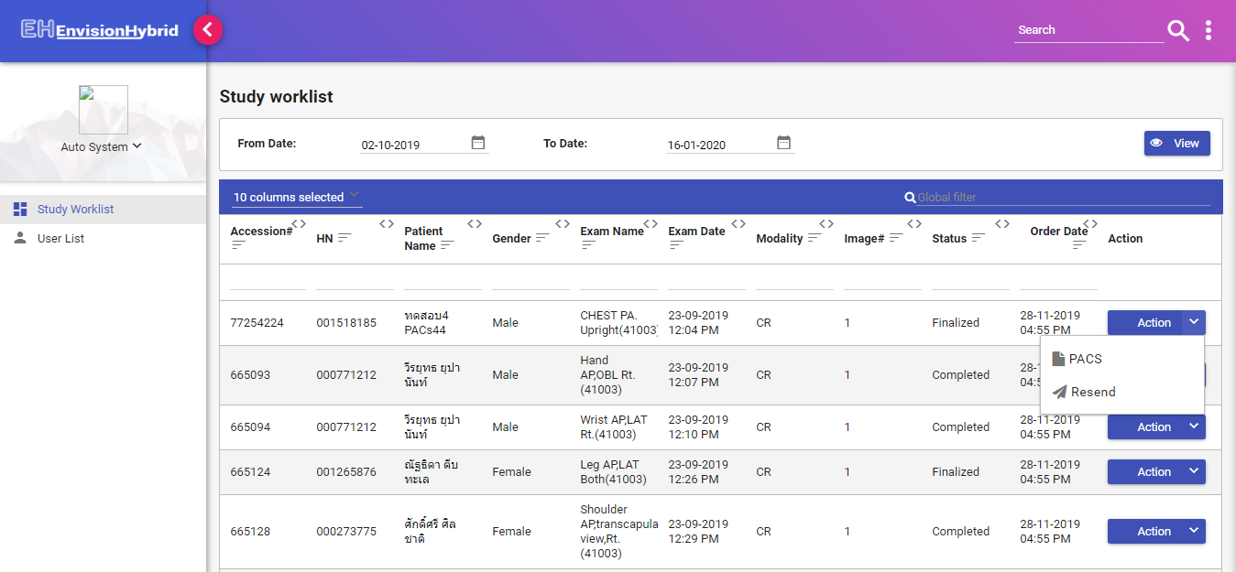
Present
Study Worklist

Slide 9
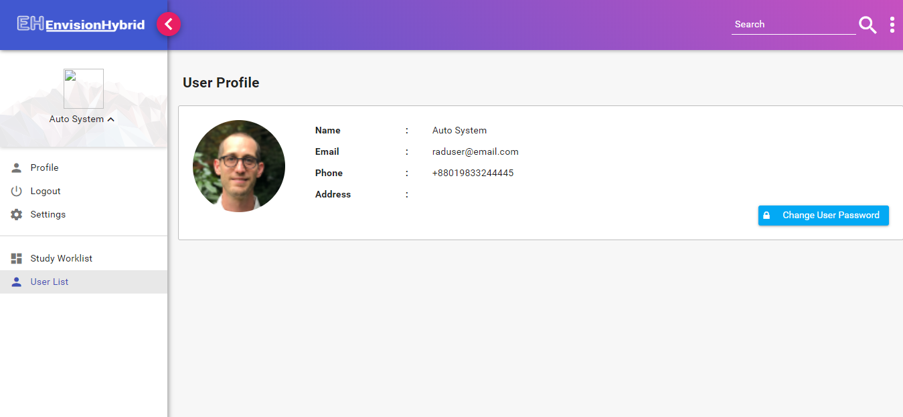
Present
User Profile

Slide 10
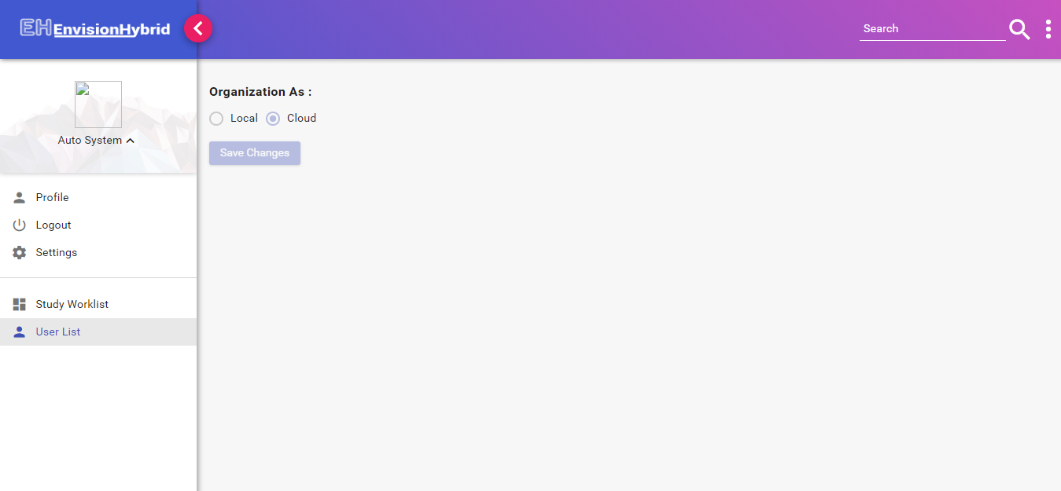
Present
Settings

Slide 11
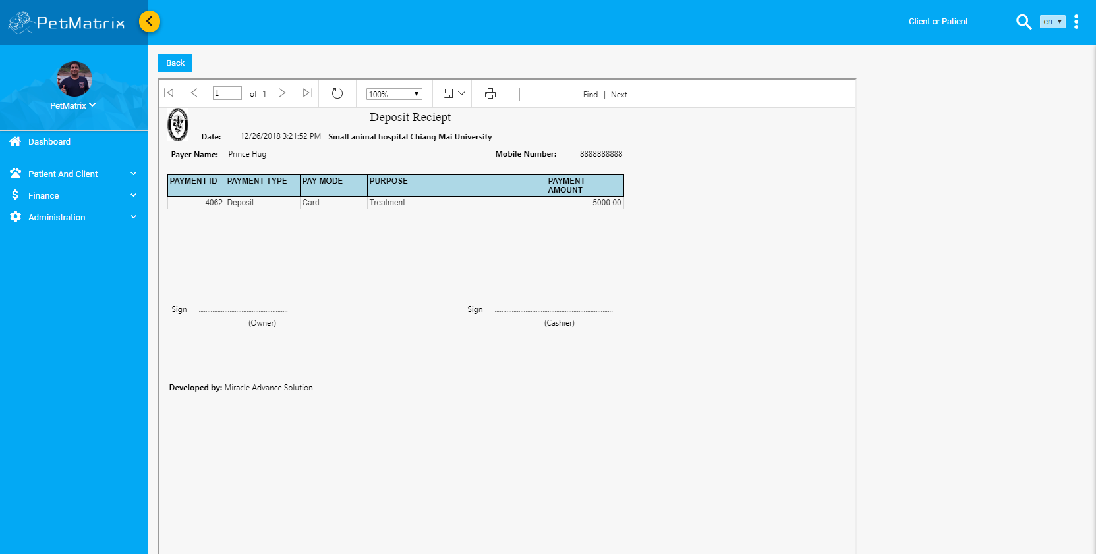
Present
Advance Payment Money Receipt

Slide 12
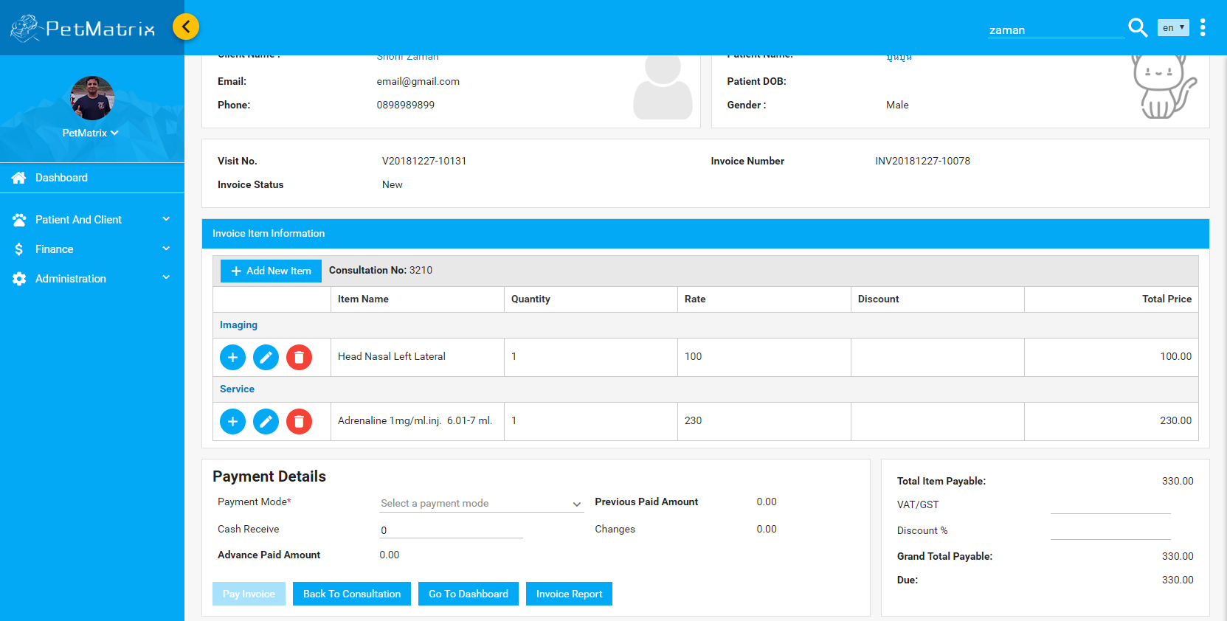
Present
Invoice

Slide 13
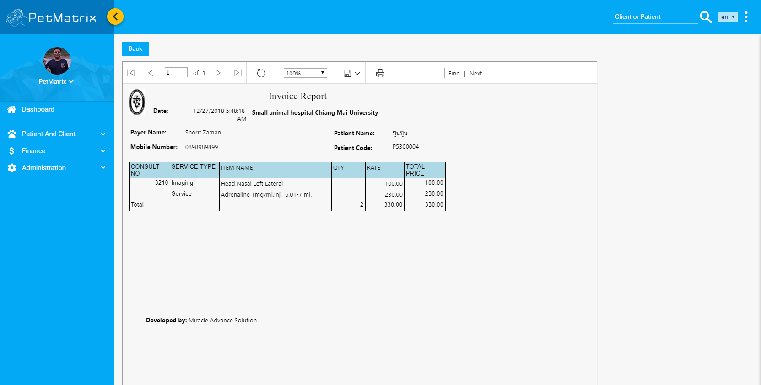
Present
Invoice Report

Slide 14
Roadmap
Inventory
IPD
LIS
RIS
OT
Emergency

Slide 15
Demo
The link of Petmatrix application
http://203.83.188.246:8087/#/

Slide 16
Thank You
Thank you everyone for your time.

